Slide 1

Program of Studies Meeting: Research Intro
Ricardo Jacome
Midwest Roadside Safety Facility
University of Nebraska-Lincoln
03/13/2020

Slide 2
Research Overview
On-Road Coordinate Decomposition for Autonomous Vehicle (AV) Guidance
Main Motivation:
AV systems depend entirely on sensors for navigation
There is a need to find alternative solutions for this problem
General Objective:
Provide a road profile for AVs to navigate on a road, independent of vehicle sensors

Slide 3
Background on AV’s
Infrastructure Only
Users: Department of Transportation, Research Institutions
Main Developments:
Passive Warning Systems
Roadside Data Storage
Main Shortcuts
No vehicle interaction
Vehicle Only
Users: Automotive Companies, Research Institutions
Main Developments:
Vehicle Sensors
Dynamic Controllers
Main Shortcuts:
Highly sensitive to visible environment inputs
Hybrid Systems

Slide 4
Background on AV’s
Hybrid Systems
Main Developments:
Infrastructure Communication Systems (V2I technology)
Examples: Traffic Lights, Speed Limits, Traffic Congestions
Main Shortcuts:
Limited to slow speed, and highly concentrated areas
Inefficient data usage
Research Question: How to improve the efficiency on hybrid systems, taking advantage of both vehicle information and infrastructure information?

Slide 5
Research Goals
A complete method to generate road profiles with the following characteristics:
Independent of data sources
Can be generated from more than one data collection method
Independent of most vehicle types
Some vehicles are not considered, for example Cargo Trucks, or Double Semi Trucks
Independent of sensor input
Useful under low visibility conditions such as rain or snow

Slide 6
Previous Work
Phase I: Literature Review
Investigation on current AV technology
Review current technology
Finding main limitations
Method brainstorming
Phase II: Smart Barrier Methodology
Obtained a framework in which the road profile can be utilized
Road Profile Generation Framework
How to formulate road profiles
How to implement with current infrastructure

Slide 7
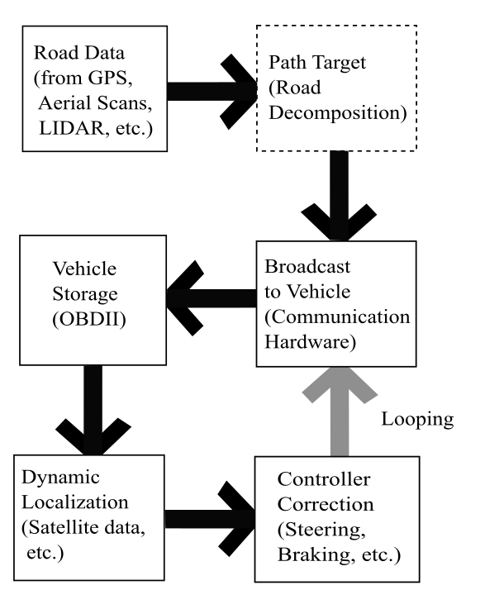
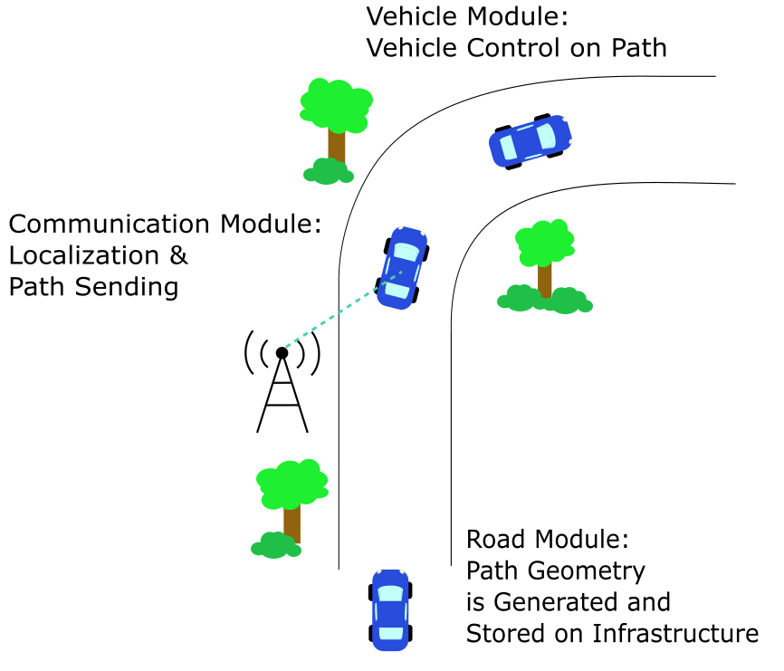
Road Profile in Overall Method

Slide 8
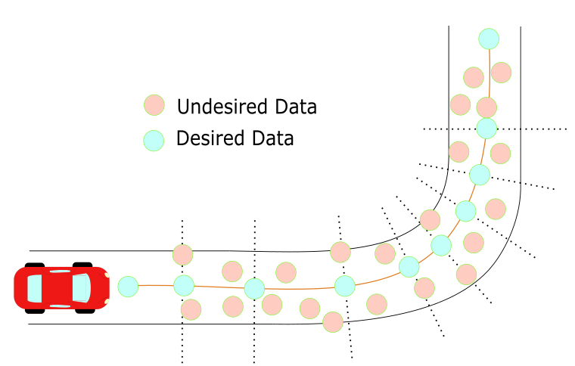
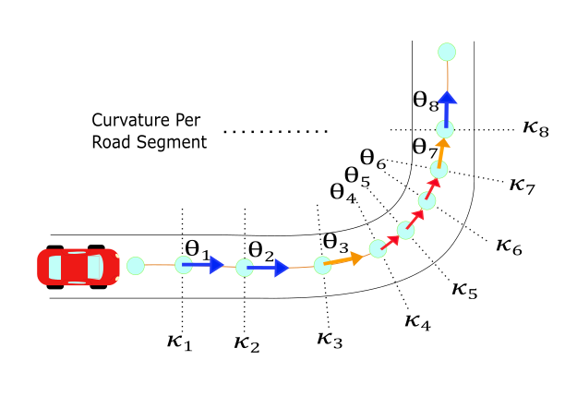
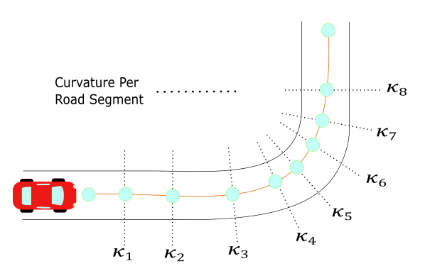
Sample Road Discretization
Data Collection
Data Filtering
Heading Generation
Notes:
Depending on method, the filtering can be different. Overall each method can be summarized with a regression to the mean of the data, and using AASHTO guidelines to remove any outlier information.

Slide 9
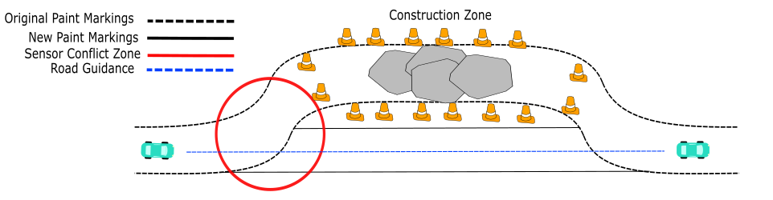
Implementation Example
This zone has conflict agreements in between the sensors and the vehicle Electronic Central Unit (i.e. steer or keep straight). Furthermore, weather factors such as rain, sand, or snow can increase the uncertainty of the vehicle to make decisions.

Slide 10
Current Work
Road Profile Filtering/Smoothing
Data can come from multiple source
Satellite scans, GPS, lidar scans
Optimization Method for Road Profile
Selection of the best trajectory dependent on certain vehicle parameters
Current Velocity, Vehicle dimensions, Street Guidelines.

Slide 11
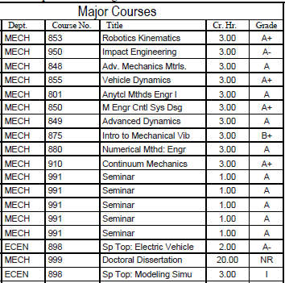
Program of Studies

Slide 12
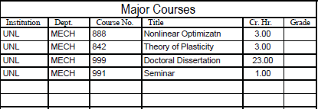
Program of Studies

